Slide 1
CAR Calibration Meeting CAR Review
AP Team
Ronald Tse, Paul Ip, Balina Ling, Simy Li and Adele Fan
June 3, 2014

Slide 2
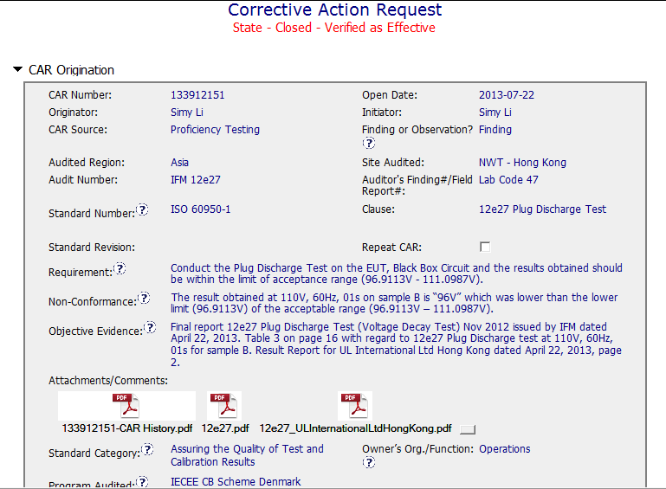
CAR# 133912151
Clear description of non-compliance – The result obtained was lower than the lower limit of the acceptable range.
Attached evidence of non-compliance report & Proficiency Test Report
Collaboration (L) : Share information and keep others informed the non-compliance.
Notes:
For the CAR# 133911678:
[CAR Review based on 00-QA-S0006 - Corrective Action Request Process]
In the session of “Non-Conformance”, there are TWO (2) discrepancies:
Failure conducting Management Review in the required time period, and
Missing input element in the Management Review process. There should be two separate root cause analysis.

Slide 3
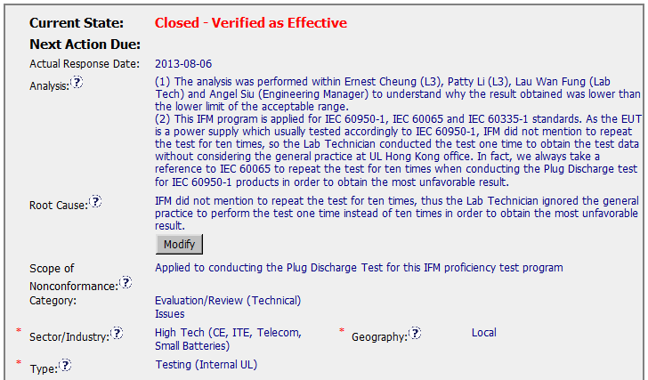
CAR# 133912151
Key stakeholders identified
Analysis shows clear path to root cause – IFM didn’t mention to repeat the test for ten times, so the lab tech only performed the test for one time & didn’t obtain the most unfavorable result.
The scope tells this nonconforming test is only limited to this IFM proficiency test program.
“Category”, “type” and “Geography” were selected.
[Competitiveness] (C) – Analysis shows clear path to root cause and scope and stakeholders identified.
[Competitiveness( (C) - Root cause statement is simple, reasonable and complete.
[Integrity] (T) – Most appropriate ‘category’, ‘type’, ‘geography’ are selected.
Notes:
Analysis – clear path to root cause; stakeholders identified
There are TWO (2) discrepancies: a) Failure conducting Management Review in the required time period, and b) Missing input element in the Management Review process. There should be two separate root cause analysis.
The “5 WHYs” approach hasn’t been utilized well because it doesn’t seem that it is able to identify the possible causes. For example, as mentioned in the “Analysis” field that “There was no general framework to set up an utilizable management review in that period. Thus the issue of the review has been postponed….” It is questionable whether it is specifically illustrated in the DEWI Quality Manual about the process and framework of Management Review, or the process is not even existing, or other reasons resulting now Management Review is not executed in the required timeframe after a personnel left the organization? The “5 WHYs” analysis can go further deeper.
In addition, does a statement “… Thus the issue of the review has been postponed.” mean that does the previous Management Review officially determine to be postponed? If yes, is there any supporting evidence?
And there is no analysis related to illustrate why “Recommendation for improvement” is not covered as input in the process of Management Review stated in the current DEWI Quality Manual.

Slide 4
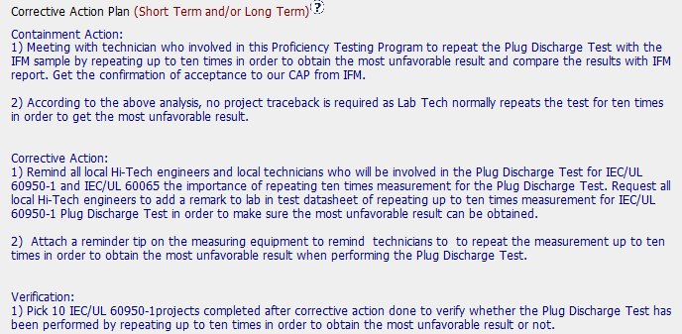
CAR# 133912151 (CAP)
Containment action : 1) to repeat the test and ensure the result falls within the acceptable range; 2) to evaluate the impact.
CAP :
Address entire root cause and items identified in the analysis. E.g.
Remind staff to repeat 10 times for Plug Discharge Test
Label the measuring equipment.
Verification : New records (DS) were reviewed to ensure CAP is effective
Milestones were set up accordingly
[Competitiveness] (C) – Corrective actions fix the objective evidence and other problems found; address entire root cause and scope.
[Competitiveness] (C) – Milestones address containment and owner’s verification; completed per milestone expectations.
[Competitiveness] (C) – Verification per requirements.
Notes:
Root Cause – is succinct; reasonable and complete based upon the analysis
Not quite sure whether how would the process and initiator of the Management Review be outlined in the Quality Manual or the related SOPs. For the instance, is there a deputy person being determined to keep running of the Management Review process for any reason the initiator is absence.
Absence of the initiator in this case is not necessary resulting the failure of the quality process. [Refer to back to the result of the root cause analysis]
As mentioned above, there should be two separate root cause analysis. Another root cause is not addressed and identified.
Scope – tells how widespread the problem is
The widespread of the discrepancy has not been addressed in this field. e.g. How would it be affected by division, operation team, function, area/region, and the time period?
Remarks: Prior to the CAR review, if I were the CAR Administrator, it is necessary to clarify what are the differences to the organizations of DEWI and DEWI Wilhelmshaven, are they different entities? And is there any operation connection to DEWI-OCC?

Slide 5
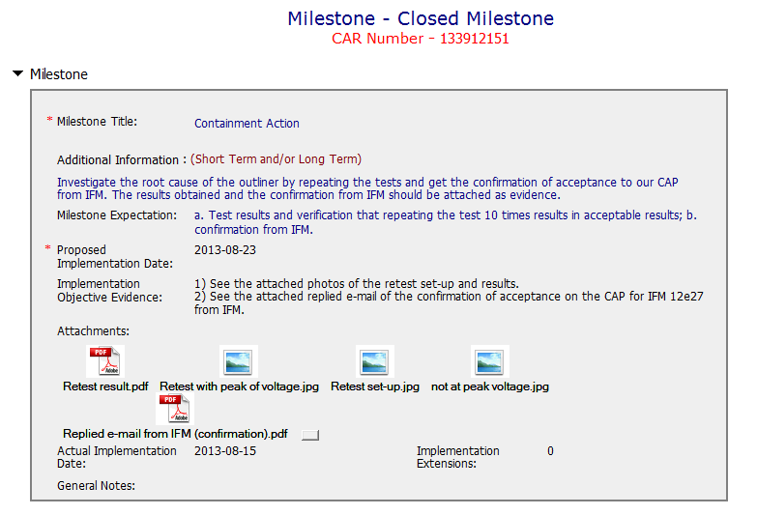
CAR# 133912151 (Milestone 1 - Containment)
Containment action – to get the correct result by repeating the test 10 times.
Repeat 10 times the test. Evidence was attached.
[Competitiveness] (C) – Milestone addressed containment and completed per milestone expectation.
Notes:
Category
→ Satisfaction
Sector/Industry
→ Satisfaction
Type
→ Satisfaction
Geography – apparent from the analysis
Not clearly illustrated in the field of “Analysis” to support it to be “Regional”.

Slide 6
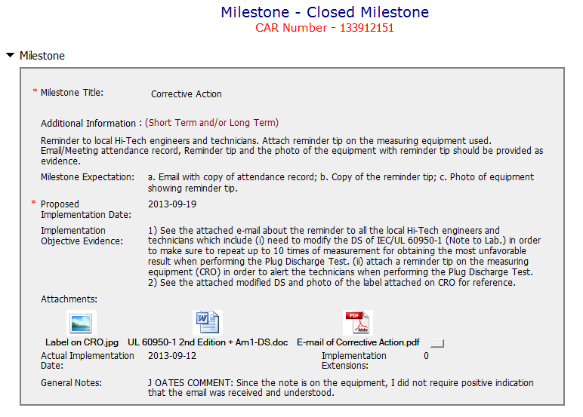
CAR# 133912151 (Milestone 2)
Milestone to remind staff and take precautions.
[Collaboration] (L) – Referenced communications are attached as needed.
[Collaboration] (C L) – CAR Champion made the note to keep the readers understand why he didn’t require the acknowledgement of understanding of the email reminder
[Competitiveness] (C) – Milestones completed per milestone expectation.
Notes:
Corrective Actions – fix the objective evidence
If it only addresses the Containment to the “Root Cause” recorded above, I think it is sufficient…
However, the reason of why failure conducting of previous Management Review is not addressed in the fields of “Root Cause” and “Correction Action Plan”.
Corrective Actions – address the entire root cause
As noted above, it is sufficient to cover the containment action though, the corrective action managing the root cause has not been addressed.
Again, there is no any corrective action related to address why “Recommendation for improvement” is not covered as input in the process of Management Review stated in the current DEWI Quality Manual.
Corrective Actions – address the items identified in the analysis
As noted above.
Corrective Actions – cover the scope and geography
Comment as stated in “Geography” above.

Slide 7
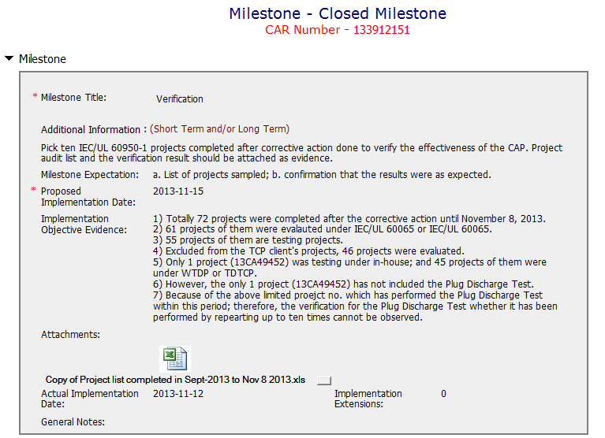
CAR# 133912151 (Milestone 3 - Verification)
Checked a total of 72 projects, no projects were found to include the test for verification. Thus created one more milestone to allow more time to do the verification.
[Integrity] (P T) – Facilitates to find the correct project for verification and acts on CARs within required timeframe.
Notes:
Good and no abnormality is found.

Slide 8
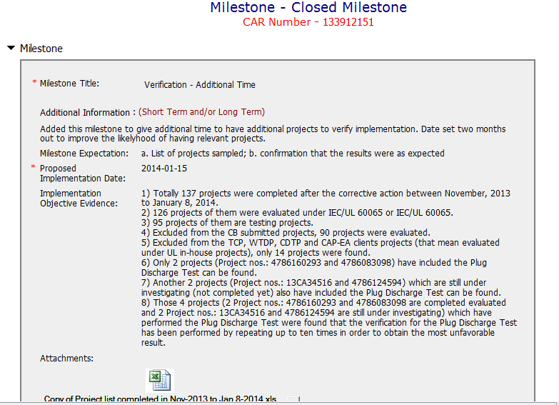
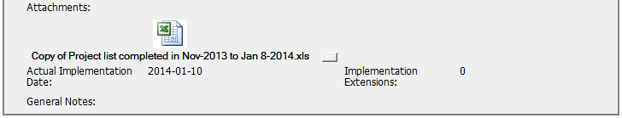
CAR# 133912151 (Milestone 4 - Verification)
Note: Please avoid creating new milestones for “additional time”. This must be handled via an extension request. We do not want extensions granted that bypass the process. Thanks. C Allison
Examined 4 projects to ensure that implemented corrective actions were effective.
[Competitiveness] (C P) – Milestone was completed per milestone expectation. The CAR Assistant could perform verification per requirements.
[Integrity] (T) – Acts on CARs within required timeframe. No extension is required.
Notes:
Milestones – address containment unless CAP indicates reason why not required
Milestone solely for containment is good but not for corrective action. [Suggest to inviting a person could read German for verification whether “Recommendation for improvement” is now covered as input in the process of Management Review.]
See below comments for corrective actions.

Slide 9
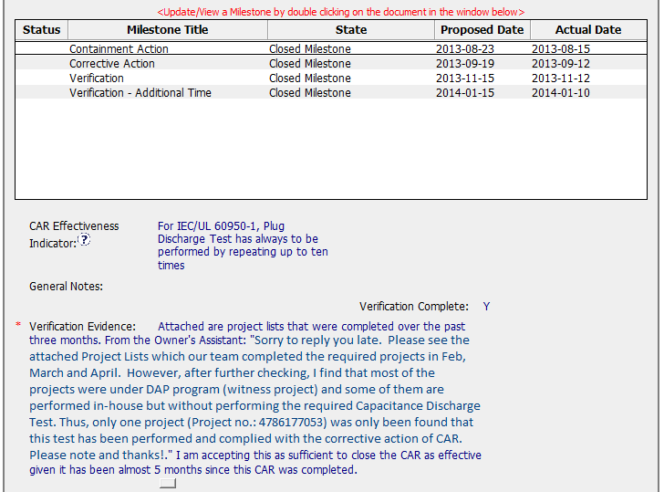
CAR# 133912151 (Milestone 4 - Verification)
CAR Effectiveness Indicator was clearly documented.
One new project was further examined within 6 months for verification of CAR effectiveness after several months’ implementation. Verification and acceptance evidence was clearly recorded.
[Integrity] (T) – Acts on CARs within required timeframe, no overdue.
Competitiveness] (P) – The CAR Champion performed verification per requirements. Verification was completed.
Notes:
Milestones – address containment unless CAP indicates reason why not required
Milestone solely for containment is good but not for corrective action. [Suggest to inviting a person could read German for verification whether “Recommendation for improvement” is now covered as input in the process of Management Review.]
See below comments for corrective actions.

Slide 10
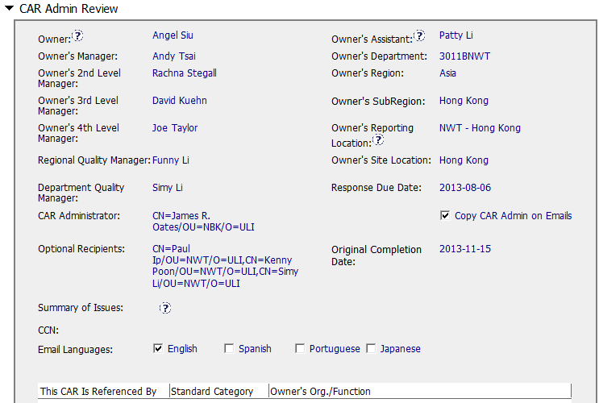
CAR# 133912151 (CAR Admin Review)
Correct input of Owner’s reporting manager.
Enter concerned personnel as optional recipients.
[Integrity] (T) – Accurately completes the administrative fields within the CAR such as Owner’s 4th Level Manager, Optional Recipients.
Notes:
Verification – completed within 6 months of CAR closure or explanation provided; enough time is allowed for new records to be examined
Please be noted that this CAR hasn’t been closed yet. It is still under a state of “Closed Awaiting Verification”, hence, the field of “Verification Evidence” is still kept empty.
However, when both root cause identification and the related corrective action stated in 2nd milestone are questionable, the comment “The corrective action was effective” stated in the field of “CAR Effectiveness Indicator” shows too generic and lack of logical consideration…
If I were the CAR Administrator, will suggest the CAR Owner to reconsider the revisit of the current Management Review process and hence fill up the loophole resulting this nonconformance by adding one or two more milestones to illustrate and support the proper completion of corresponding efforts / activities. The timeline of last milestone for CAR Owner self-verification could be set right after completion of Management Review for Year 2013.
For the “General Notes”, shouldn’t it be an analysis field provided by CAR Owner instead of CAR Admin?

Slide 11
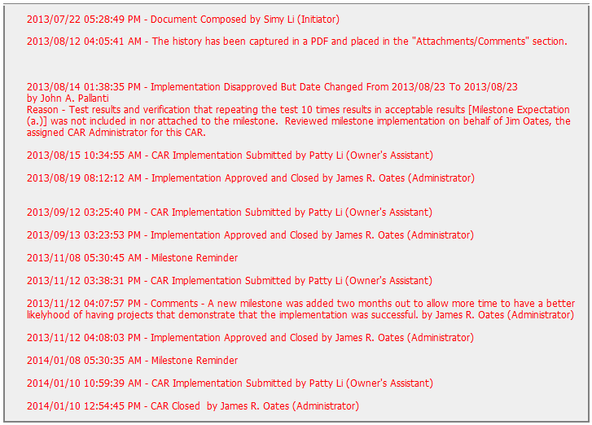
CAR# 133912151
CAR Champion provided feedback to CAR owner / assistant.
John Pallanti served as a backup to support CAR Champion, Jim Oates
[Collaboration] (L) – Other CAR Champion to support this CAR Champion on his absence.
Notes:
Extensions – within requirements (<30 days, 3 or less)
The number of extensions is still meeting the requirement.
Other than this, suggest sending e-mail in advance to remind CAR Owner separately to avoid CAR overdue and/or escalation. Put the communication with CAR Owner into the CAR DB as evidence.

Slide 12
CAR# 133912151 (Overall Comment)
Good analysis of the finding CAR.
Good identification of root cause. Corrective actions are taken based on the analysis and root cause identified.
Verification of projects that were involved the concerned tests was taking very serious.
Collaboration between CAR Champions (John Pallantic and Jim Oates support each other) and CAR owner (CAR Owner / Assistant acted on advice received from John Pallantic).
Notes:
Milestones – have final milestone for owner’s verification of effectiveness; enough time is allowed for new records to be examined
Although CAR owner self-verification is added at the last milestone, it doesn’t cover the corrective action for the failure conducting previous Management Review.
In fact, would the next round of Management Review be able to conducted on-time, it has not been addressed.
It is suggested that the verification should focus on whether the updated process and/or next round of Management Review is in place to avoid recurrence of such nonconformity.
Milestones – completed per milestone expectations
It is acceptable as Containment Action for the supporting evidence covered in the 1st milestone, i.e. Management Review Report for Year 2011 and Year 2012 [Suggest to inviting a person could read German for verification…].
However, the evidence “Attachment of the management review 2013 in milestone one. The effectiveness of the management review was reviewed by the EULA Region Quality Manager and found to be acceptable.” stated in the 2nd milestone is irrelevant while the Management Review for Year 2013 has not been conducted yet. Not sure how CAR Administrator accepts it.
In addition, for 2nd milestone, it is suggested that a statement should be provided by CAR Owner to indicate that “Recommendation for improvement” is now covered as input in the process of Management Review for Year 2011 and 2012...

